Slide 1
Cryptographic Math-2
Notes:
Lecture slides by Lawrie Brown for “Network Security Essentials”, 4/e, by William Stallings, Chapter 9 – “Public Key Cryptography and Message Authentication”.

Slide 2
Algebraic Structures

Slide 3
Finite fields have become increasingly important in cryptography. A number of cryptographic algorithms rely heavily on properties of finite fields, notably the Advanced Encryption Standard (AES) and elliptic curve cryptography.
Fields are a subset of a larger class of algebraic structures called rings, which are in turn a subset of the larger class of groups. In fact, as shown in Figure ,both groups and rings can be further differentiated. Groups are defined by a simple set of properties and are easily understood. Each successive subset (abelian group, ring, commutative ring, and so on) adds additional properties and is thus more complex.

Slide 4
Finite fields are a subset of fields, consisting of those fields with a finite number of elements. These are the class of fields that are found in cryptographic algorithms. With the concepts of fields in hand, we turn in Section 5.4 to a specific class of finite fields, namely those with p elements, where p is prime. Certain asymmetric cryptographic algorithms make use of such fields.
A more important class of finite fields, for cryptography, comprises those with 2n elements depicted as fields of the form GF(2n). These are used in a wide variety of cryptographic algorithms. However, before discussing these fields, we need to analyze the topic of polynomial arithmetic, which is done in Section 5.5

Slide 5
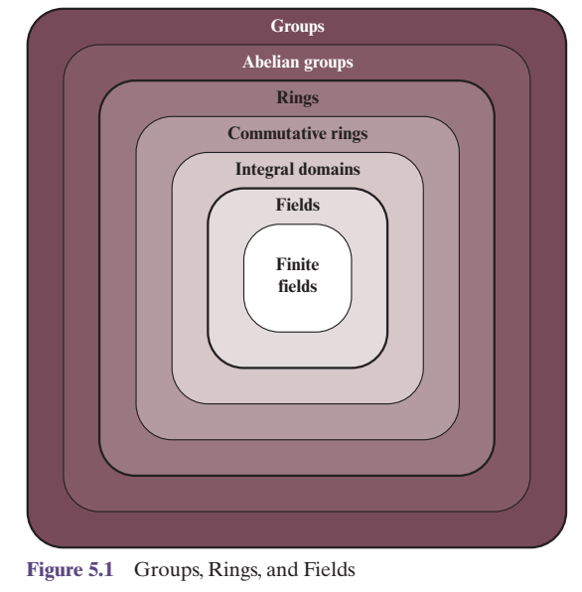
With all of this preliminary work done, we are able at last, to discuss finite fields of the form GF(2n).

Slide 6
Groups, rings, and fields are the fundamental elements of a branch of mathematics known as abstract algebra, or modern algebra. In abstract algebra, we are concerned with sets on whose elements we can operate algebraically; that is, we can combine two elements of the set, perhaps in several ways, to obtain a third element of the set. These operations are subject to specific rules, which define the nature of the set. By convention, the notation for the two principal classes of operations on set elements is usually the same as the notation for addition and multiplication on ordinary numbers. However, it is important to note that, in abstract algebra, we are not limited to basic arithmetical operations. All this should become clear as we proceed.

Slide 7
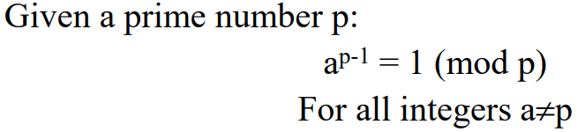


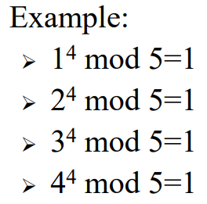
Fermat's Little Theorem

Slide 8
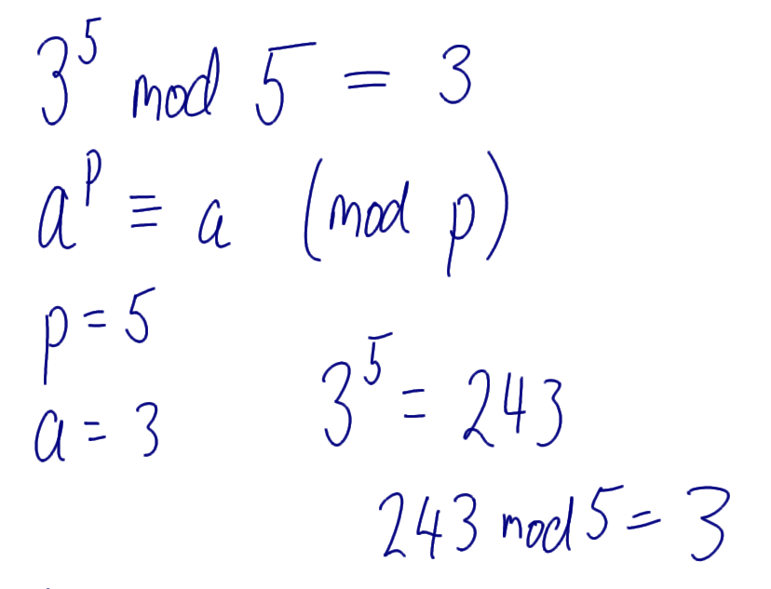
Fermats Theorem Example

Slide 9
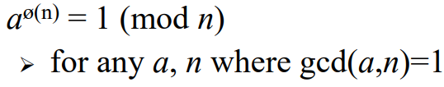
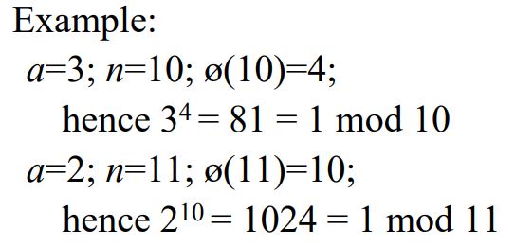

Euler's Theorem

Slide 10
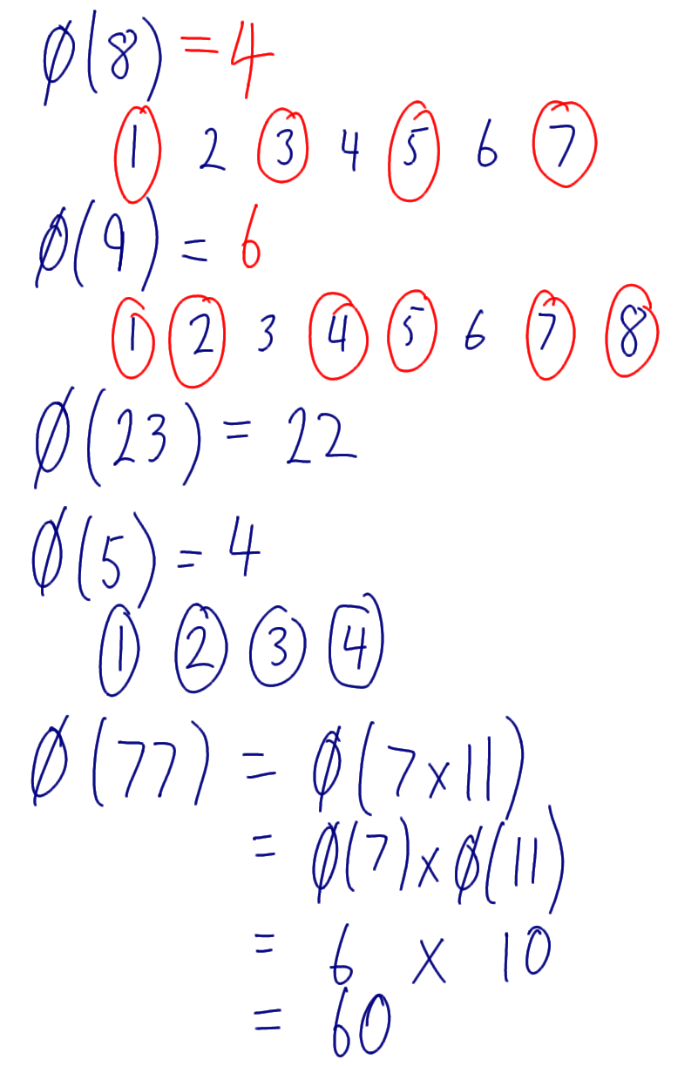
Eulers Totient Function;

Slide 11
Discrete Logarithm Example

Slide 12
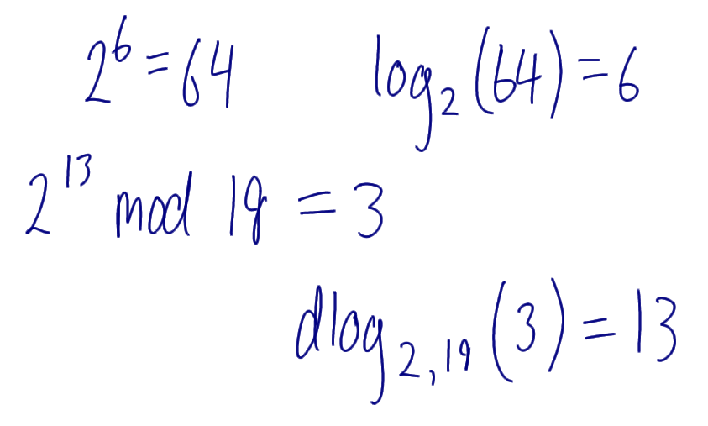
Discrete Logarithm Example;

Slide 13
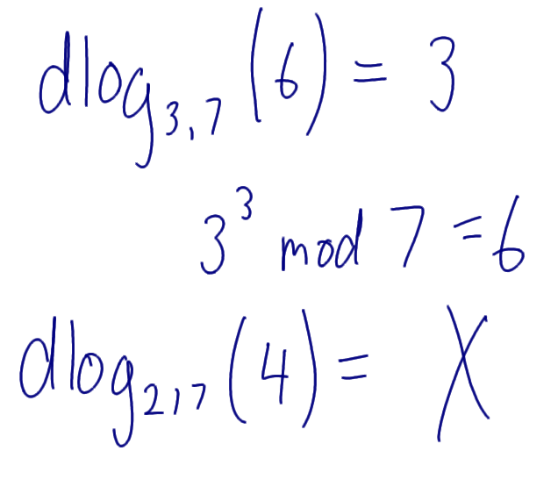
Discrete Log Example

Slide 14
Primitive Root Example

Slide 15
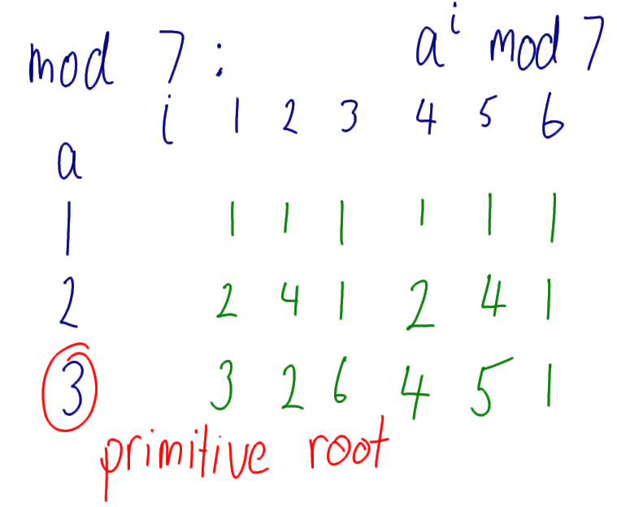
Primitive Root Example;

Slide 16
Algebraic Structures
To review the concept of algebraic structures
To define and give some examples of groups
To define and give some examples of rings
To define and give some examples of fields
To emphasize the finite fields of type GF(2^{n}) that make it possible to perform operations such as addition, subtraction, multiplication, and division on n-bit words in modern block ciphrs

Slide 17
Algebraic Structures
Cryptography requires sets of integers and specific operations that are defined for those sets. The combination of the set and the operations that are applied to the elements of the set is called an algebraic structure. We will define three common algebraic structures: groups, rings, and fields.
Topics :
1 Groups
2 Rings
3 Fields

Slide 18
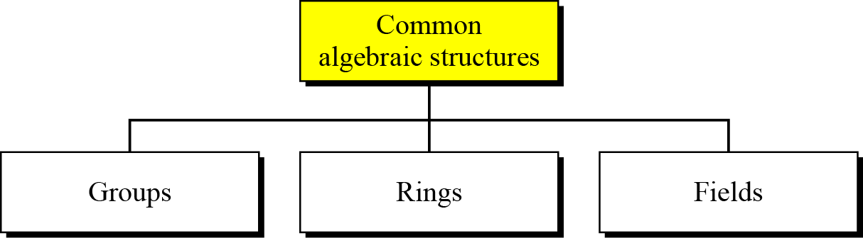
Algebraic Structures
The combination of the set and the operations that are applied to the elements of the set is called algebraic structure.

Slide 19
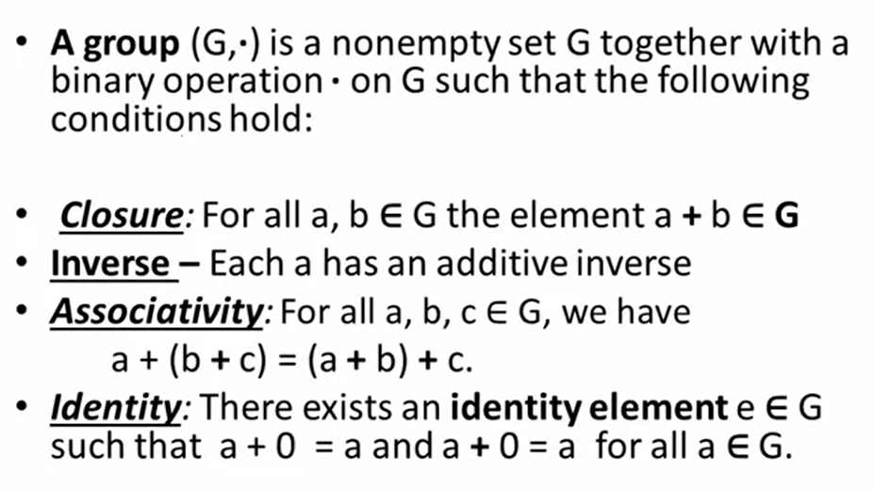
Group

Slide 20
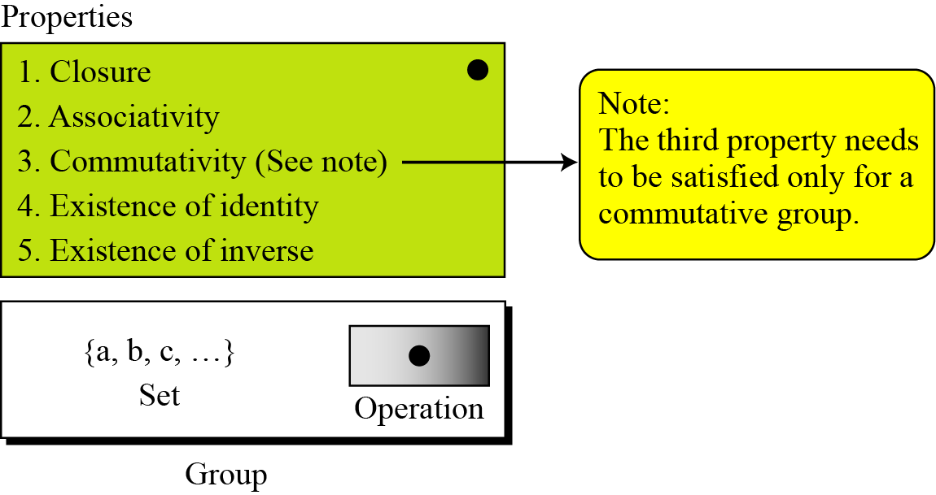
Group

Slide 21
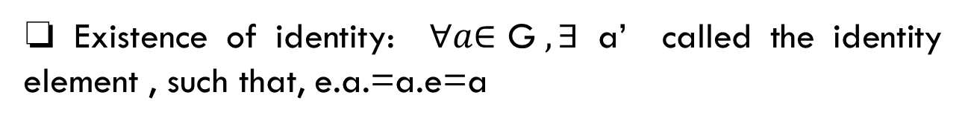
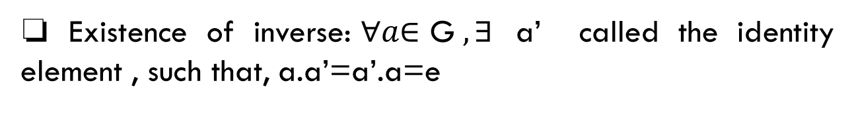
Algebraic Structures: Group
A group (G) is a set of elements with a binary operation (•) that satisfies four properties (or axioms). A commutative group (also called abelian group) satisfies an extra property, commutativity:
❏ Closure: if a,b∈ G, then c=a.b ∈G
❏ Associativity: if a,b,c ∈ G, then (a.b).c=a. (b.c)
❏ Commutativity: if a,b∈ G, then a.b=b.a
❏ Existence of identity: $∀a\text{∈ }\text{G} , ∃$ a’ called the identity element , such that, e.a.=a.e=a
❏ Existence of inverse:$∀a\text{∈ }\text{G} , ∃$ a’ called the identity element , such that, a.a’=a’.a=e

Slide 22
Continued
Application
Although a group involves a single operation, the properties imposed on the operation allow the use of a pair of operations as long as they are inverses of each other.
Example
The set of residue integers with the addition operator,
G = < Z_{n} , +>,
is a commutative group. We can perform addition and subtraction on the elements of this set without moving out of the set.

Slide 23
Continued
Example
The set Zn* with the multiplication operator, G = <Zn*, ×>, is also an abelian group.
Example
Let us define a set G = < {a, b, c, d}, •> and the operation as shown in Table

Slide 24
Group
Abelian Group: A commutative group also called an abelian group, is a group in which the operator satisfies the four properties for groups plus an extra property , commutativity.
a.b = b.a
Example: Z8, + modular addition, identity =0

Slide 25
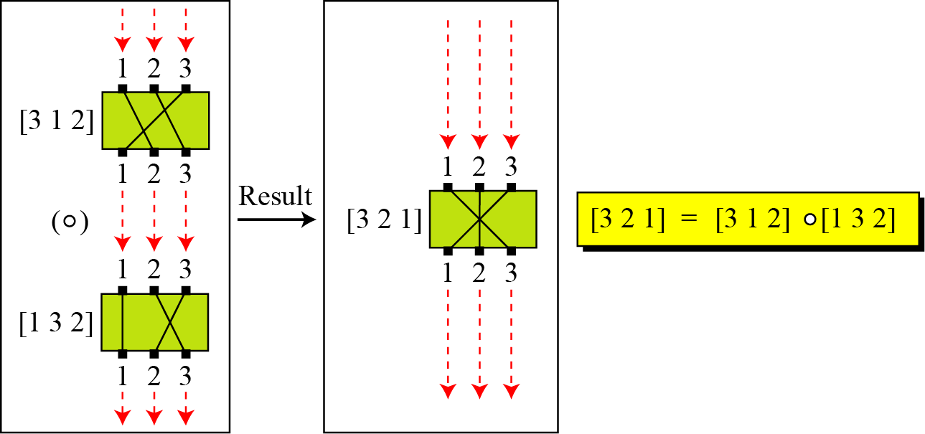
Group (cont.)
In a group the elements in the set do not have to be numbers. The can be, rules, mappings, functions or even actions. A very interesting group is the permutation group. The set is the set of all permutations, and the operation is composition: applying one permutation after another.
Figure Composition of permutation

Slide 26
Group (cont.)
Example
Table Operation table for permutation group

Slide 27
Group (cont.)
Example
In the previous example, we showed that a set of permutations with the composition operation is a group. This implies that using two permutations one after another cannot strengthen the security of a cipher, because we can always find a permutation that can do the same job because of the closure property.

Slide 28
Group (cont.)
Finite Group: has a finite number of elements
Order of a Group: |G| =number of elements in a group
Subgroups: If G=<S,.> is a group and H=<T,.> is also
a group under the same operation and T is the nonempty
subset of H, then H is a subgroup of G

Slide 29
Group
Is the group H = <Z₁₀, +> a subgroup of the group G = <Z₁₂, +>?
Solution
The answer is no. Although H is a subset of G, the operations defined for these two groups are different. The operation in H is addition modulo 10; the operation in G is addition modulo 12.

Slide 30
Cyclic Group
Exponentiation: Repeated application of operator .
example: a³ = a.a.a
Cyclic Group: If a subgroup of a group can be generated using the power of an element, the subgroup is called the cyclic subgroup. The term power here means repeatedly applying the group operation to the element .
b = a^{k} for some a and every b in group
  a is said to be a generator of the group
  Note that, a⁰=e
Example: {1, 2, 4, 8} with mod 12 multiplication, the generator is 2.
2⁰=1, 2¹=2, 2²=4, 2³=8, 2⁴=4, 2⁵=8

Slide 31
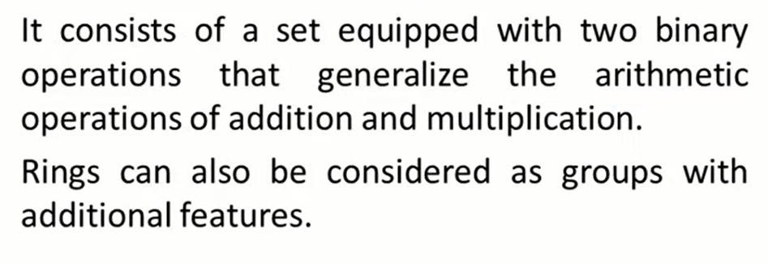
Ring

Slide 32
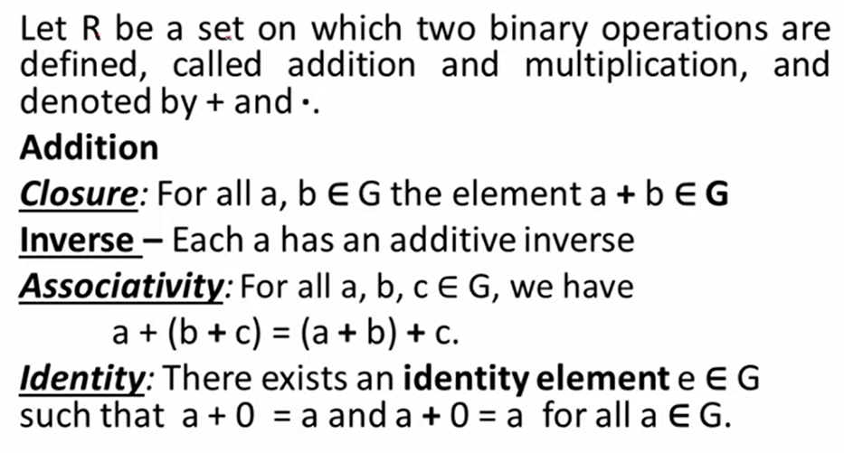
Ring

Slide 33
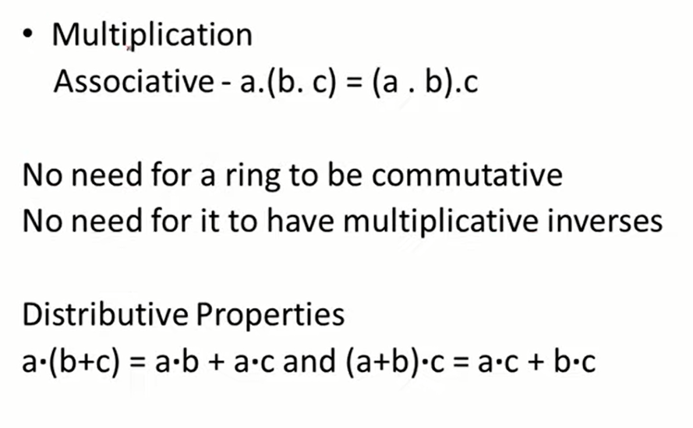
Ring

Slide 34
Ring
Ring: R=< {…}, .,# >
  1. A group with two operations: addition and multiplication
2. The group is Abelian with respect to addition: a+b = b+a (1st operation, all )
3. Multiplication and additions are both associative: (2nd operation only first two)
a+(b+c)=(a+b)+c
a.(b.c)=(a.b).c
4. Multiplication (2nd opearation) distributes over addition (ist operation)
a.(b+c)=a.b+a.c
(a+b).c = a.c + b.c
Commutative Ring: Multiplication is commutative, i.e.,
a.b = b.a
Integral Domain: multiplication operation has an identity and no zero divisors

Slide 35
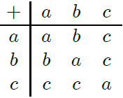
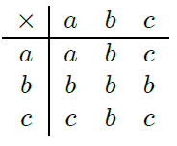
Ring
Consider the set S = {a, b} with addition and multiplication defined by the following tables:
Is S a ring? Justify.

Slide 36
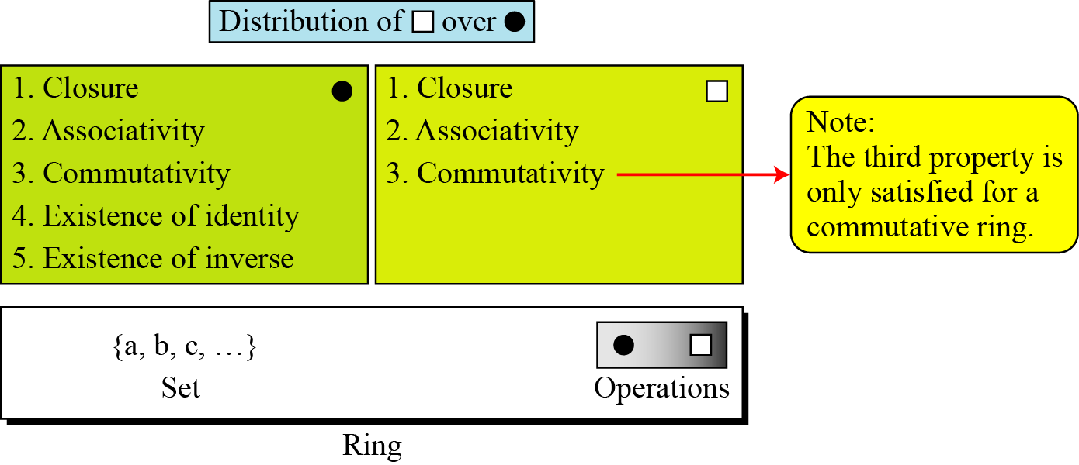
The set Z with two operations, addition and multiplication, is a commutative ring. We show it by R = <Z, +, ×>. Addition satisfies all of the five properties; multiplication satisfies only three properties.

Slide 37
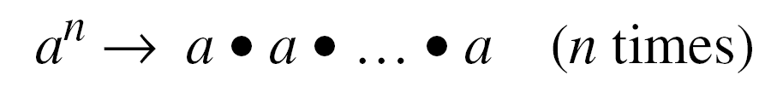
Cyclic Subgroups
If a subgroup of a group can be generated using the power of an element, the subgroup is called the cyclic subgroup. Power means repeatedly applying the group operation.
example: a³ = a.a.a

Slide 38

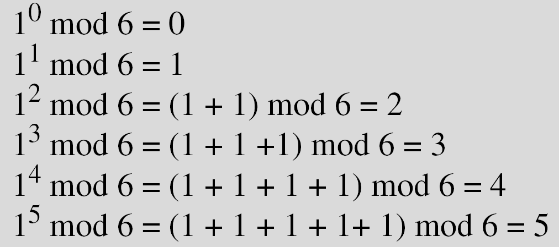
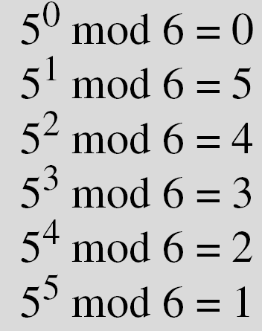
Cyclic Subgroups
Example
Four cyclic subgroups can be made from the group G = <Z₆, +>. They are H₁ = <{0}, +>, H₂ = <{0, 2, 4}, +>, H₃ = <{0, 3}, +>, and H₄ = G.

Slide 39
Cyclic Subgroups
Example
Three cyclic subgroups can be made from the group
G = <Z10∗, ×>. G has only four elements: 1, 3, 7, and 9. The cyclic subgroups are H1 = <{1}, ×>, H2 = <{1, 9}, ×>, and H3 = G.

Slide 40
Cyclic Subgroups
Example
A cyclic group can have many generators.
Three cyclic subgroups can be made from the group
G = <Z10∗, ×>. G has only four elements: 1, 3, 7, and 9. The cyclic subgroups are H1 = <{1}, ×>, H2 = <{1, 9}, ×>, and H3 = G.
a. The group G = <Z6, +> is a cyclic group with two generators,
g = 1 and g = 5.
b. The group G = <Z10∗, ×> is a cyclic group with two generators,
g = 3 and g = 7.

Slide 41
Lagrange’s Theorem
Lagrange’s theorem relates the order of a group to the order
of its subgroup.
Assume that G is a group, and H is a subgroup of G. If the order of G and H are |G| and |H|, respectively, then, based on this theorem, |H| divides |G|.
Order of an Element
The order of an element a in a group, ord(a) is the smallest integer n such that a^{n}=e.
In other words, The order of an element is the order of the cyclic group it generates.

Slide 42
Example
The set Z with two operations, addition and multiplication, is a commutative ring. We show it by R = <Z, +, ×>. Addition satisfies all of the five properties; multiplication satisfies only three properties.
e.g.,
5ˣ(3+2)=(5ˣ3)+(5ˣ2)=25

Slide 43
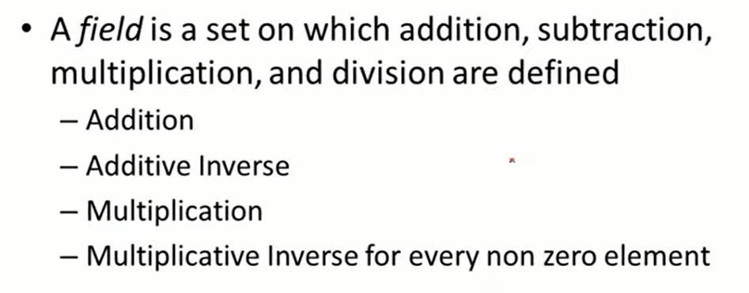
Field

Slide 44
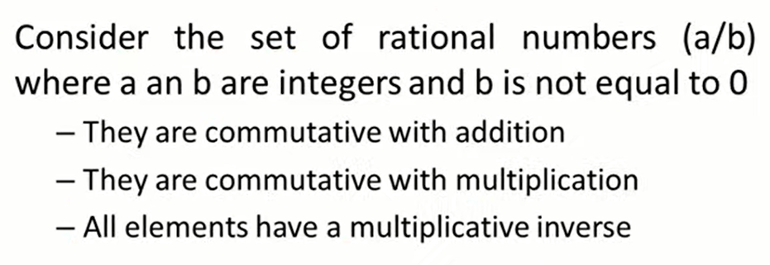
Field

Slide 45
Field
Ring: R=< {…}, .,# > is a commutative ring in which the second operation satisfies all five properties defined for the first opeation except that the identity of the first operation has no inverse.
  1. A group with two operations: addition and multiplication
2. The group is Abelian with respect to addition: a+b = b+a (1st operation, all )
3. Multiplication and additions are both associative: (2nd operation only first two)
a+(b+c)=(a+b)+c
a.(b.c)=(a.b).c
4. Multiplication (2nd opearation) distributes over addition (ist operation)
a.(b+c)=a.b+a.c
(a+b).c = a.c + b.c
Commutative Ring: Multiplication is commutative, i.e.,
a.b = b.a
Integral Domain: multiplication operation has an identity and no zero divisors

Slide 46
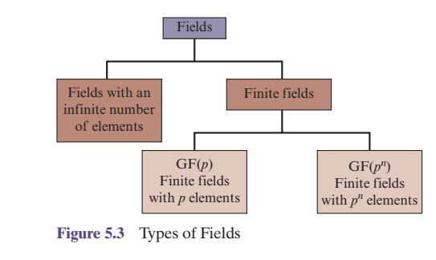

Slide 47
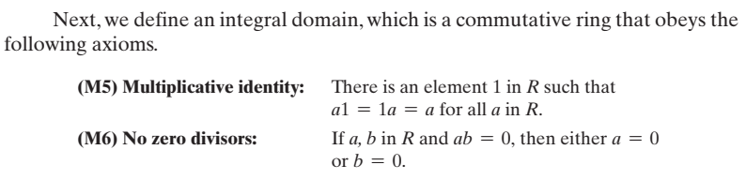

Slide 48
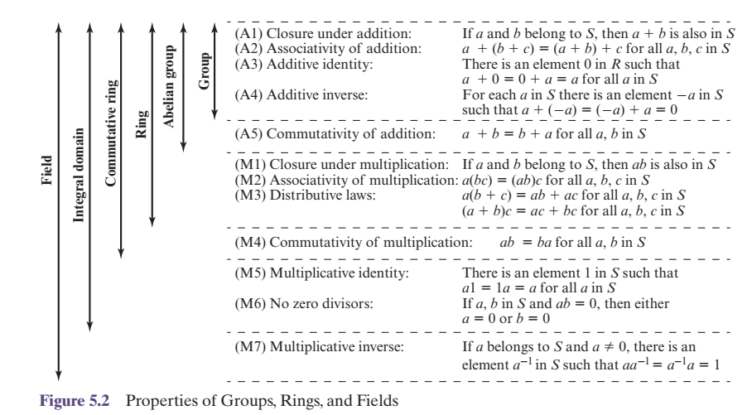

Slide 49
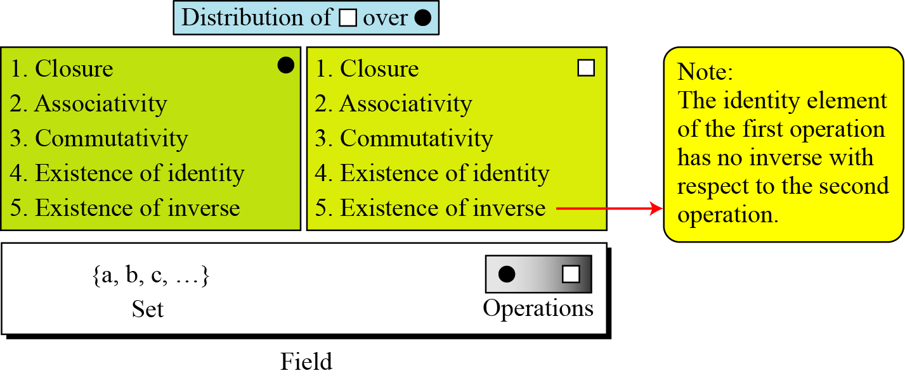
A field, denoted by F = <{…}, •, > is a commutative ring in which the second operation satisfies all five properties defined for the first operation except that the identity of the first operation has no inverse.
A field is a structure that supports two pairs of operations that we have used in matematics; addition/ subtraction and multiplication/division. There is one exception : division by zero is not allowed.

Slide 50
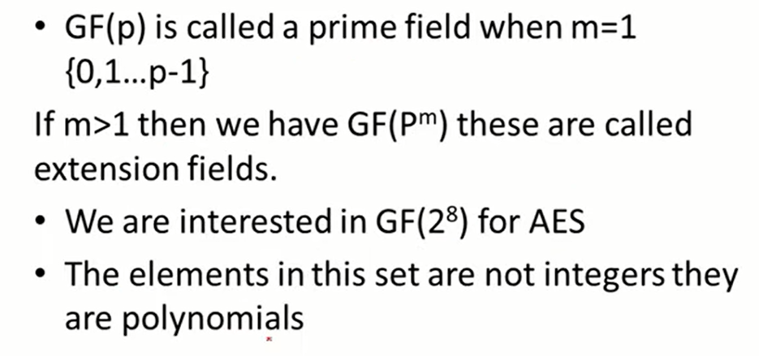
Prime Fields and Extension field

Slide 51
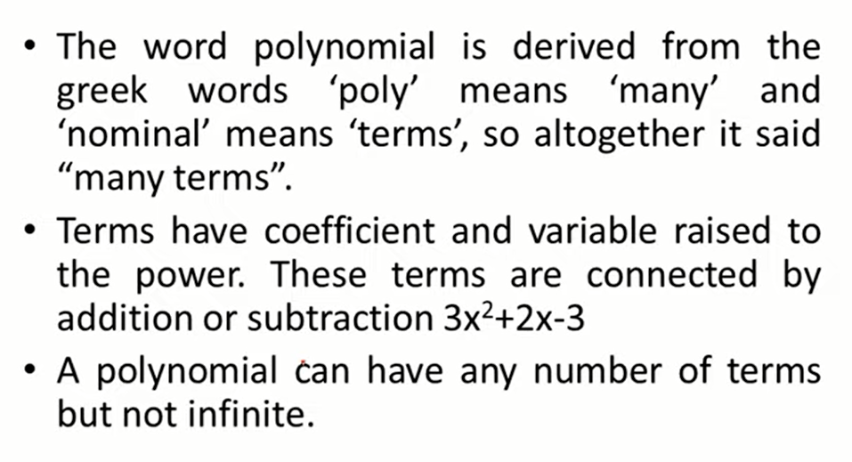
What is a Polynomial?

Slide 52
Continued
Finite Fields
Although we have fields of infinite order, only finite fields extensively used in cryptography.
Galois showed that for a field to be finite, the number of elements should be p^{n}, where p is a prime and n is a positive integer.
A Galois field, GF(p^{n}), is a finite field with p^{n} elements.

Slide 53
Continued
GF(p) Fields
When n = 1, we have GF(p) field. This field can be the set Z_{p}, {0, 1, …, p − 1}, with two arithmetic operations (addition and multiplication).
Note that each element in this set has an additive inverse and that nonzero elements have a multiplicative inverse (no multiplicative inverse for 0)

Slide 54
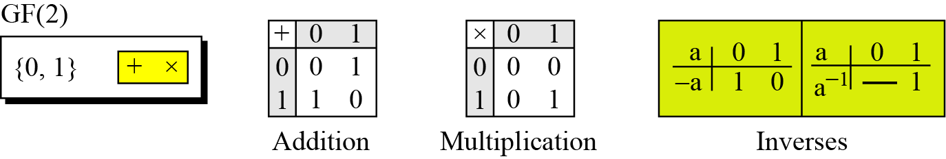
Example
A very common field in this category is GF(2) with the set {0, 1} and two operations, addition and multiplication, as shown in Figure.
GF(2) field

Slide 55
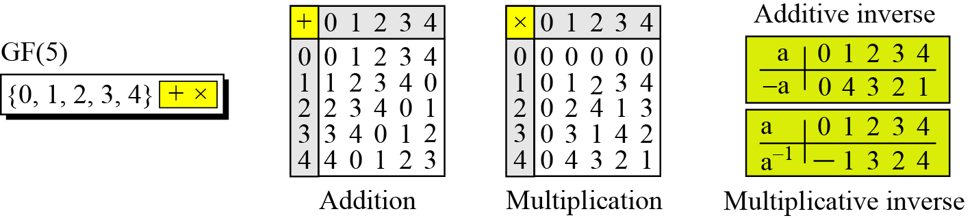
Continued
Example
We can define GF(5) on the set Z₅ (5 is a prime) with addition and multiplication operators as shown in Figure.
Figure GF(5) field

Slide 56
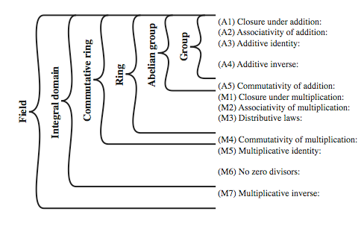
Field
Field: An integral domain in which each element has a multiplicative inverse.

Slide 57
Finite Field
Finite Field: A field with finite number of elements
Also known as Galois Field
The number of elements is always a power of a prime number. Hence, denoted as GF(p^{n})
GF(p) is the set of integers {0,1, … , p-1} with arithmetic operations modulo prime p
Can do addition, subtraction, multiplication, and division without leaving the field GF(p)
GF(2) = Mod 2 arithmetic GF(8) = Mod 8 arithmetic
There is no GF(6) since 6 is not a power of a prime.

Slide 58
Example
A very common field in this category is GF(2) with the set {0, 1} and two operations, addition and multiplication, as shown in Figure.
Figure GF(2) field

Slide 59
Example
We can define GF(5) on the set Z₅ (5 is a prime) with addition and multiplication operators as shown in Figure.
Figure GF(5) field

Slide 60
Table Summary

Slide 61
GF(2^{n}) FIELDS
In cryptography, we often need to use four operations (addition, subtraction, multiplication, and division). i.e., we need to use fields. However, in computers positive integers are stored as n-bit words (0- 2^{n-1}, modulus is 2^{n} . We can work in GF(2^{n}) and uses a set of 2^{n} elements. The elements in this set are n-bit words.
Topics to be discussed:
1 Polynomials
2 Using A Generator
3 Summary

Slide 62
GF(2^{n}) FIELDS
If we want fields, we have two choices:
Use GF(p) but where 2^{n-1}<p (many numbers unused)
We can use GF(2^{n-1}), however we cannot interpret each element as an integer (because regular four operations cannot be applied, the modulus 2^{n} is not a prime), we need to define a set of n-bit words and two new operations that satisfies the properties defined for a field.
Topics to be discussed:
1 Polynomials
2 Using A Generator
3 Summary

Slide 63
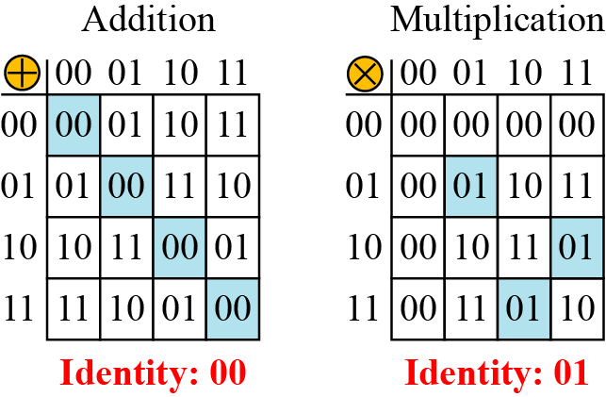
Continued
Example
Let us define a GF(2²) field in which the set has four 2-bit words: {00, 01, 10, 11}. We can redefine addition and multiplication for this field in such a way that all properties of these operations are satisfied, as shown in Figure. (additive and multiplicative inverse, addition and multiplication (except 00) are defined in terms of polynomials.
Figure An example of GF(2²) field

Slide 64
Polynomials
Although we can directly define the rules for addition and multiplication operations on n-bit words that satisfy the properties in GF(2^{n}). It is easier to work with a representation of n-bit words a polynomial of degree n − 1 which is an expression of the form
where x^{i} is called the ith term and a_{i} is called coefficient of the ith term.

Slide 65
Polynomials
Power of x defines the position of the bit in the n-bit word.
The co-efficient defines the value (but only 0 or 1)
Operations: operations on co-efficients and operations on two polynomials. We need two fields, one for co-efficients (GF(2)) and one for polynomials (GF 2^{n}).
Modulus: Addition of two polynomilas never creates a polynomial out of the st. But for multiplication, may. So for this sets of polynomials in GF 2^{n} a group of polynomials of degree n is defined as the modulus. The act as prime polynomial, can not be factored into a polynomial with degree of less than n. also irreducible polynomials. Number of terms are odd.

Slide 66
Polynomials
Ordinary polynomial arithmetic:
  Add, subtract, multiply, divide polynomials,
  Find remainders, quotient.
  Some polynomials have no factors and are prime.
Polynomial arithmetic with mod p coefficients
Polynomial arithmetic with mod p coefficients and mod m(x) operations, where m(x) is a n-th degree polynomial = GF(p^{n})

Slide 67
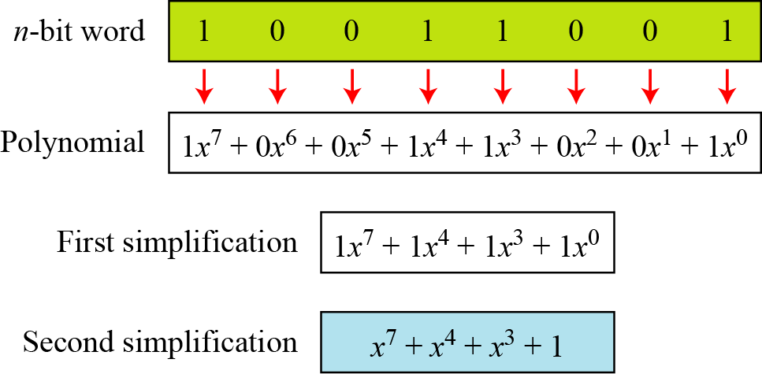
Polynomials
Figure show how we can represent the 8-bit word (10011001) using a polynomials.
Figure Representation of an 8-bit word by a polynomial

Slide 68
To find the 8-bit word related to the polynomial x⁵ + x² + x, we first supply the omitted terms. Since n = 8, it means the polynomial is of degree 7. The expanded polynomial is
This is related to the 8-bit word 00100110.

Slide 69
GF(2^{n}) Fields
Polynomials representing n-bit words use two fields: GF(2) and GF(2^{n}).

Slide 70
Continued
Modulus
For the sets of polynomials in GF(2^{n}), a group of polynomials of degree n is defined as the modulus. Such polynomials are referred to as irreducible polynomials.
Table List of irreducible polynomials

Slide 71
Addition
Addition and subtraction operations on polynomials are the same operation.

Slide 72
Addition
Let us do (x⁵ + x² + x) ⊕ (x³ + x² + 1) in GF(2⁸). We use the symbol ⊕ to show that we mean polynomial addition. The following shows the procedure:

Slide 73
Addition
There is also another short cut. Because the addition in GF(2) means the exclusive-or (XOR) operation. So we can exclusive-or the two words, bits by bits, to get the result. In the previous example, x⁵ + x² + x is 00100110 and x³ + x² + 1 is 00001101. The result is 00101011 or in polynomial notation x⁵ + x³ + x + 1.
Additive identity: is a zero polynomial. (adding a polynomial with itelf)

Slide 74
Multiplication
1. The coefficient multiplication is done in GF(2).
2. The multiplying x^{i} by x^{j} results in x^{i+j}.
3. The multiplication may create terms with degree more than n − 1, which means the result needs to be reduced using a modulus polynomial.

Slide 75
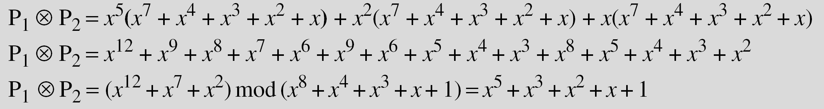
Multiplication
Find the result of (x⁵ + x² + x) ⊗ (x⁷ + x⁴ + x³ + x² + x) in GF(2⁸) with irreducible polynomial (x⁸ + x⁴ + x³ + x + 1). Note that we use the symbol ⊗ to show the multiplication of two polynomials.
Solution
To find the final result, divide the polynomial of degree 12 by the polynomial of degree 8 (the modulus) and keep only the remainder. Figure shows the process of division. Next Slide ->

Slide 76
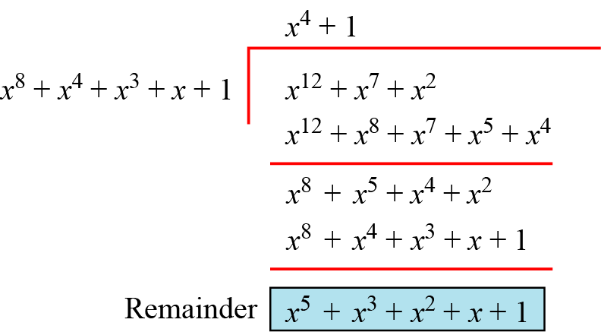
Polynomial Division (Cont. from prev. slide)

Slide 77
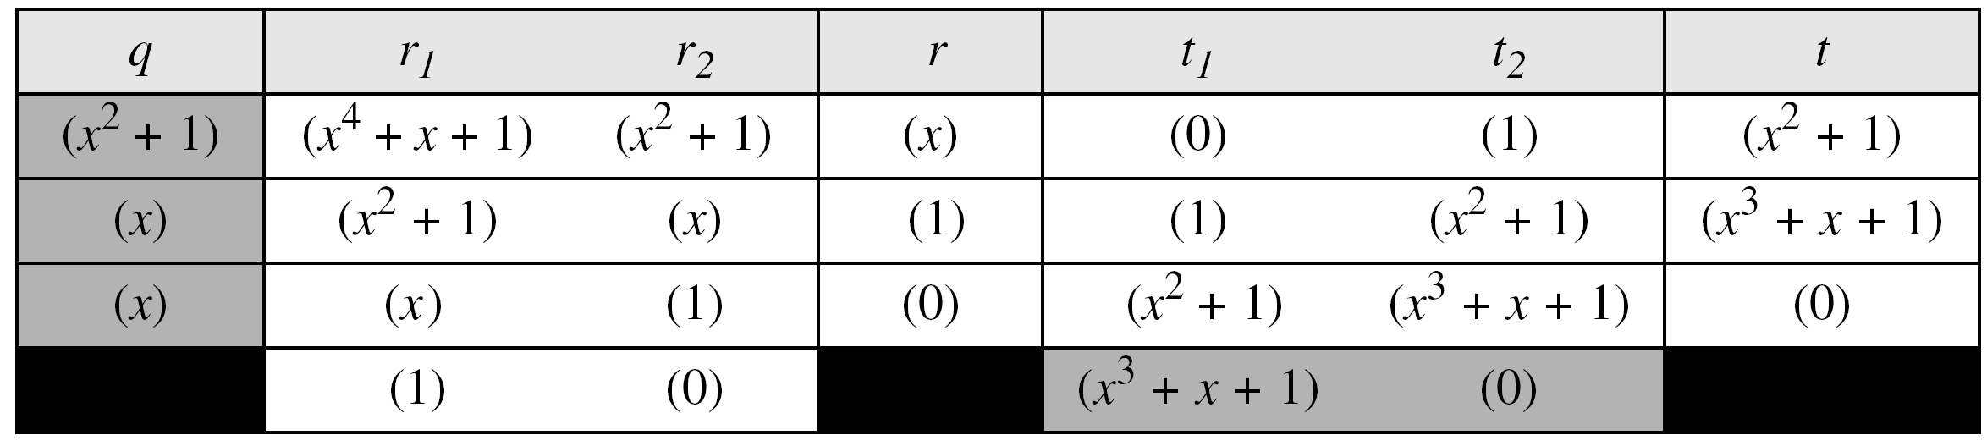
Multiplication (cont.)
In GF (2⁴), find the inverse of (x² + 1) modulo (x⁴ + x + 1).
Solution
The answer is (x³ + x + 1) as shown I the Table (Using Euclidean Algo.).
Multiplicative identity: 1, e.g. in GF (2⁸), it is 00000001
Multiplicative Inverse: Extended Eucleadean Algorithm must be applied to the modulus and the polynimials.

Slide 78
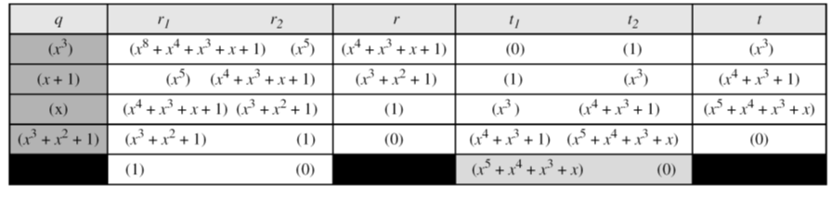
Continued
Example
In GF(2⁸), find the inverse of (x⁵) modulo (x⁸ + x⁴ + x³ + x + 1).
Solution
The answer is (x⁵ + x⁴ + x³ + x) as shown in Table (Eucld Algo).
Table Euclidean algorithm for Example

Slide 79
Multiplication by Computer
The computer implementation uses a better algorithm, repeatedly multiplying a reduced polynomial by x.

Slide 80
Multiplication by Computer
Find the result of multiplying P₁ = (x⁵ + x² + x) by P₂ = (x⁷ + x⁴ + x³ + x² + x) in GF(2⁸) with irreducible polynomial (x⁸ + x⁴ + x³ + x + 1) using the algorithm described above.
Solution
The process is shown in the Table in next slide. We first find the partial result of multiplying x⁰, x¹, x², x³, x⁴, and x⁵ by P₂. Note that although only three terms are needed, the product of x^{m} ⊗ P₂ for m from 0 to 5 because each calculation depends on the previous result.

Slide 81
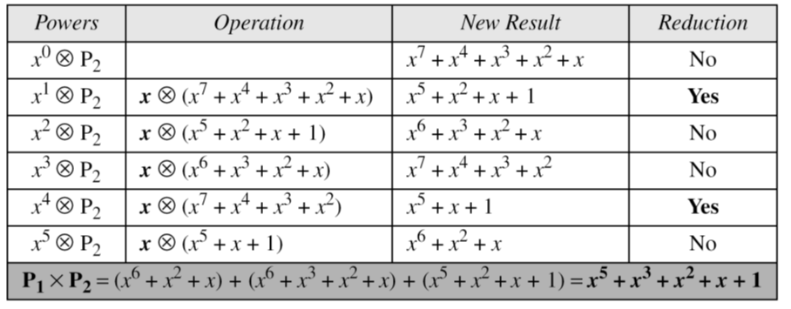
Multiplication by Computer
Table An efficient algorithm

Slide 82
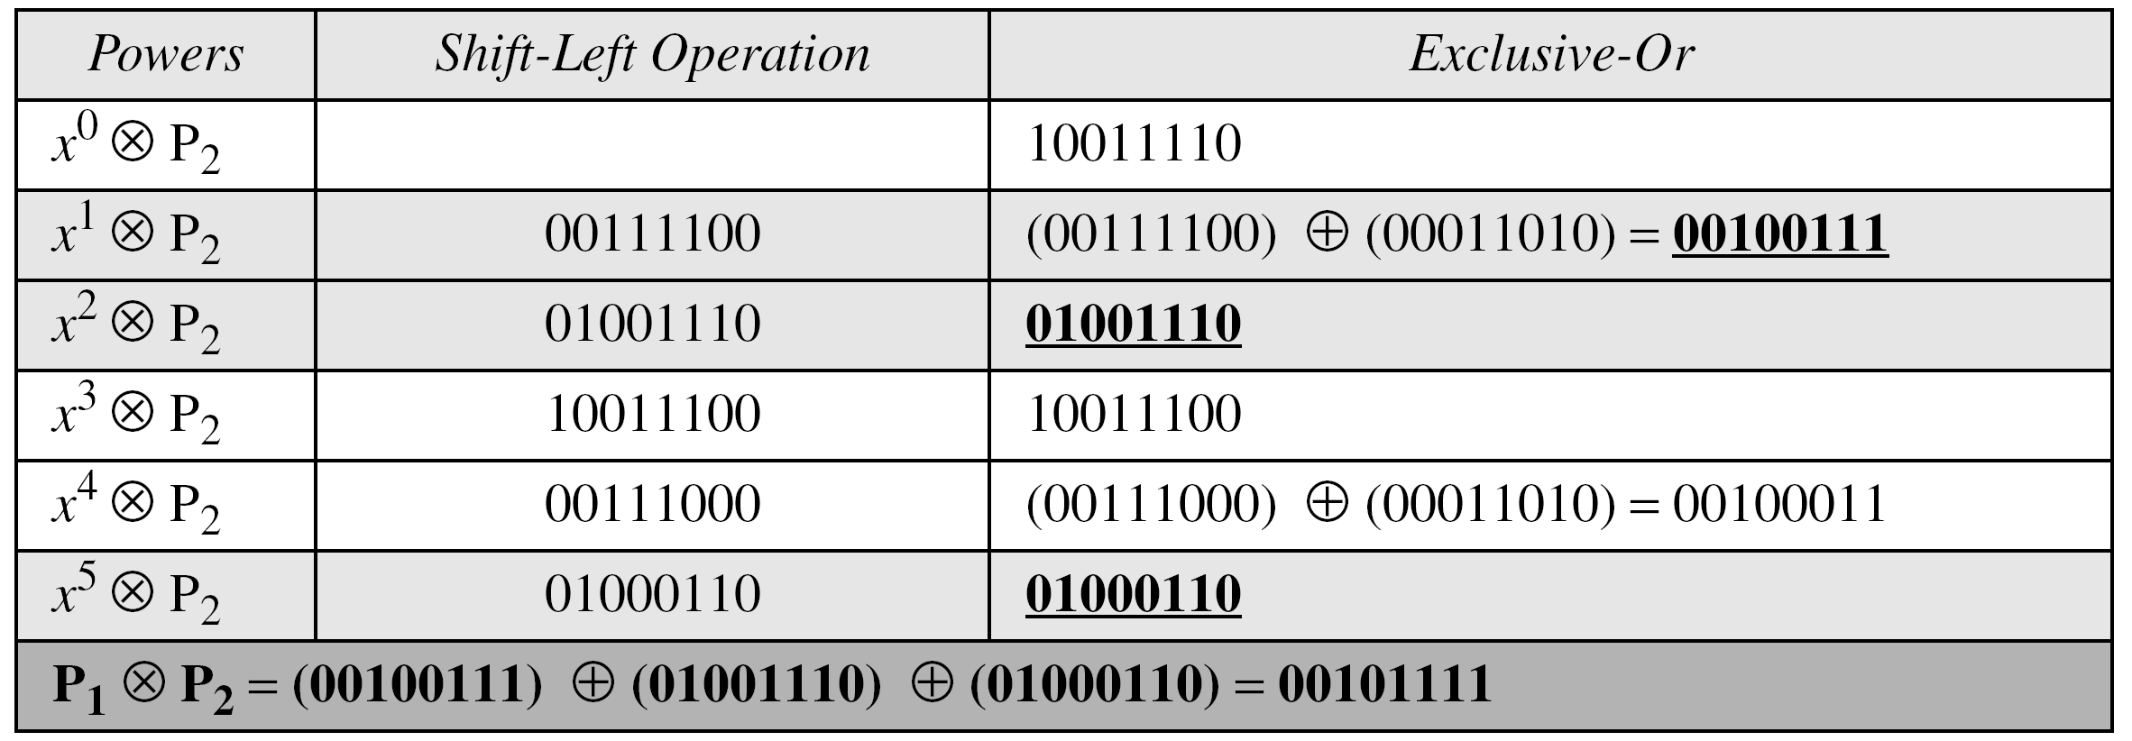
Multiplication by Computer
Repeat the same using bit patterns of size 8.
Solution
We have P1 = 000100110, P2 = 10011110, modulus = 100011010 (nine bits). We show the exclusive or operation by Å.
Table An efficient algorithm for multiplication using n-bit words

Slide 83
Multiplication Using bit-patterns
The GF(2³) field has 8 elements. We use the irreducible polynomial (x³ + x² + 1) and show the addition and multiplication tables for this field. We show both 3-bit words and the polynomials. Note that there are two irreducible polynomials for degree 3. The other one, (x³ + x + 1), yields a totally different table for multiplication.

Slide 84
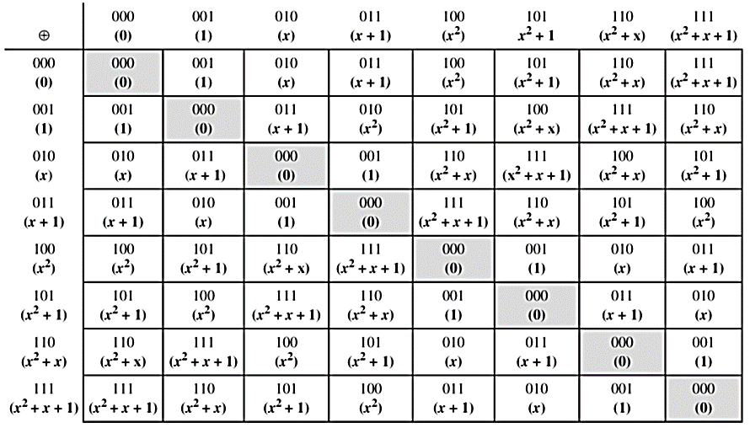
Addition table for GF(2³)mod
(x³ + x² + 1)

Slide 85
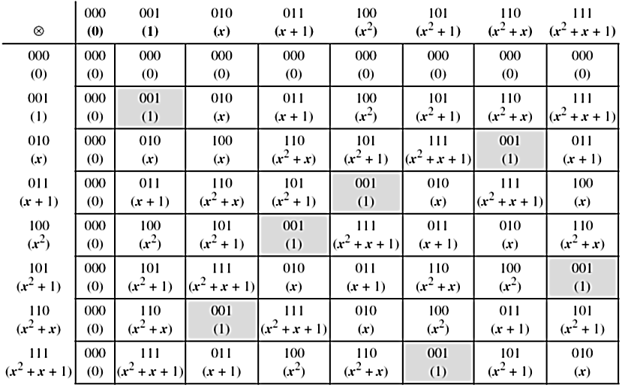
Multiplication table for GF(2³) mod
(x³ + x² + 1)

Slide 86
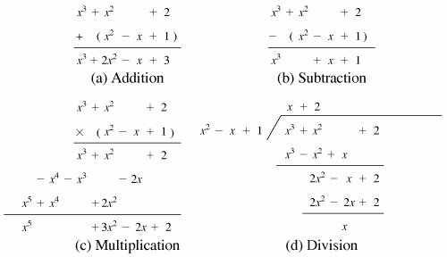
Ordinary Polynomial Arithmetic

Slide 87
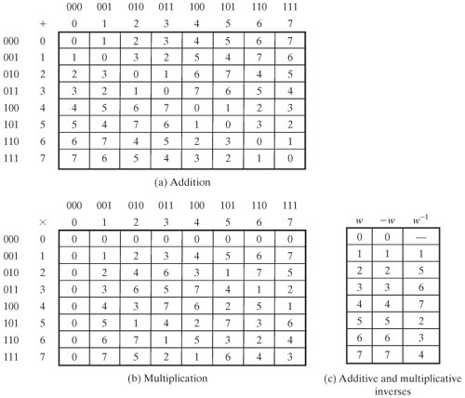
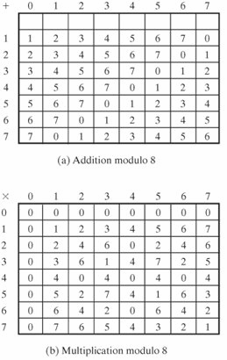
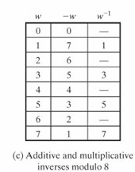
Integer
Occurrences in Z₈
Occurrences in GF(2³)
1 2 3 4 5 6 7
4 8 4 12 4 8 4
7 7 7 7 7 7 7
Z₈
GF(2³)

Slide 88
Computational Considerations
since coefficients are 0 or 1, can represent any such polynomial as a bit string
addition becomes XOR of these bit strings
multiplication is shift & XOR
  long-hand multiplication
modulo reduction done by repeatedly substituting highest power with remainder of irreducible poly (also shift & XOR)
Notes:
See text for additional discussion. Reduction comes from observation that if in GF(2^{n}) then irreducible poly g(x) has highest term x^{n} , and if compute x^{n} mod g(x) answer is g(x)- x^{n}

Slide 89
Example
why mod(x³+x+1) for GF(2³)
in GF(2³) have (x²+1) is 101₂ & (x²+x+1) is 111₂
so addition is
  (x²+1) + (x²+x+1) = x
  101 XOR 111 = 010₂
and multiplication is
  (x+1).(x²+1) = x.(x²+1) + 1.(x²+1)
  = x³+x+x²+1 = x³+x²+x+1
  011.101 = (101)<<1 XOR (101)<<0 =
  1010 XOR 101 = 1111₂
polynomial modulo reduction (get q(x) & r(x)) is
  (x³+x²+x+1 ) mod (x³+x+1) = 1.(x³+x+1) + (x²) = x²
  1111 mod 1011 = 1111 XOR 1011 = 0100₂
Notes:
Show here a few simple examples of addition, multiplication & modulo reduction in GF(2³).
Note the long form modulo reduction finds p(x)=q(x).m(x)+r(x) with r(x) being the desired remainder.

Slide 90


Slide 92

Example GF(2³)
Notes:
92
Example shows addition & multiplication in GF(2³) modulo (x³+x+1), from Stallings Table 476.

Slide 93




GF(7)
The simplest finite field is GF(2).
Notes:
From Stallings Table 4-3b.

Slide 94



Slide 95
Computational Example
in GF(2³) have (x²+1) is 101₂ & (x²+x+1) is 111₂
so addition is
  (x²+1) + (x²+x+1) = x
  101 XOR 111 = 010₂
and multiplication is
  (x+1).(x²+1) = x.(x²+1) + 1.(x²+1)
  = x³+x+x²+1 = x³+x²+x+1
  011.101 = (101)<<1 XOR (101)<<0 =
  1010 XOR 101 = 1111₂
Notes:
95
Show here a few simple examples of addition, multiplication & modulo reduction in GF(2³).
Note the long form modulo reduction finds p(x)=q(x).m(x)+r(x) with r(x) being the desired remainder.

Slide 96

Computational Example (con't)
in GF(2³) have (x²+1) is 101₂ & (x²+x+1) is 111₂
polynomial modulo reduction (get q(x) & r(x)) is
  (x³+x²+x+1 ) mod (x³+x+1) = 1.(x³+x+1) + (x²) = x²
  1111 mod 1011 = 1111 XOR 1011 = 0100₂
Notes:
96
Show here a few simple examples of addition, multiplication & modulo reduction in GF(2³).
Note the long form modulo reduction finds p(x)=q(x).m(x)+r(x) with r(x) being the desired remainder.

Slide 97
Summary
Have considered:
  Concept of groups, rings, fields
  Finite fields gf(p)
  Polynomial arithmetic in general and in GF(2^{n})
Notes:
97
Chapter 4 summary.

Slide 98
Annex

Slide 99


Using a Generator
Sometimes it is easier to define the elements of the GF(2^{n}) field using a generator.

Slide 100
4.2.1 Continued
Example
Generate the elements of the field GF(2⁴) using the irreducible polynomial ƒ(x) = x⁴ + x + 1.
Solution
The elements 0, g⁰, g¹, g2, and g³ can be easily generated, because they are the 4-bit representations of 0, 1, x², and x³. Elements g⁴ through g¹⁴, which represent x⁴ though x¹⁴ need to be divided by the irreducible polynomial. To avoid the polynomial division, the relation ƒ(g) = g⁴ + g + 1 = 0 can be used .

Slide 101
4.2.1 Continued
Example
Continued

Slide 102
4.2.1 Continued
Example
The following show the results of addition and subtraction operations:

Slide 103
4.2.1 Continued
Example
The following show the result of multiplication and division operations:.

Slide 104


Slide 105


Slide 106
GCD Revisited

Slide 107
Greatest Common Divisor
The greatest common divisor of two positive integers is the largest integer that can divide both integers.
Euclidean Algorithm
Fact 1: gcd (a, 0) = a
Fact 2: gcd (a, b) = gcd (b, r), where r is
the remainder of dividing a by b

Slide 108

Continued
Figure Euclidean Algorithm
When gcd (a, b) = 1, we say that a and b are relatively prime.

Slide 109
Continued
When gcd (a, b) = 1, we say that a and b are relatively prime.

Slide 110
Continued
Example
Find the greatest common divisor of 2740 and 1760.
Solution
We have gcd (2740, 1760) = 20.

Slide 111

Continued
Example
Find the greatest common divisor of 25 and 60.
Solution
We have gcd (25, 65) = 5.

Slide 112

Continued
Extended Euclidean Algorithm
Given two integers a and b, we often need to find other two integers, s and t, such that
The extended Euclidean algorithm can calculate the gcd (a, b) and at the same time calculate the value of s and t.

Slide 113

Continued
Figure Extended Euclidean algorithm, part a

Slide 114

Continued
Extended Euclidean algorithm, part b

Slide 115
Continued
Example
Given a = 161 and b = 28, find gcd (a, b) and the values of s and t.
Solution
We get gcd (161, 28) = 7, s = −1 and t = 6.

Slide 116
Continued
Example
Given a = 17 and b = 0, find gcd (a, b) and the values of s
and t.
Solution
We get gcd (17, 0) = 17, s = 1, and t = 0.

Slide 117
Continued
Example
Given a = 0 and b = 45, find gcd (a, b) and the values of s
and t.
Solution
We get gcd (0, 45) = 45, s = 0, and t = 1.

